Slide 2
How has the American Dream changed in the last century?
For this History discursive writing assignment you are required to research how the American Dream has changed between 1920 and the present day. Your findings will be recorded so that you can evidence the wider research and reading that you have carried out in order to write a 2000 word answer to address the question: How has the American Dream changed in the last century?
This is a very current topic, and will take you on a journey through modern American history - its highs and lows - and lead you right up to the present day under the Trump administration.
You will need to show you have thought about different people: social class, race, gender - as these all play a factor in what constitutes the American Dream, and the extent to which it was ever achievable. Does race today still play a factor in the American Dream? Does the accessibility of the American Dream link directly to your social class? And have peoples dreams changed with American history? These are all questions you will be asking (and answering) in this assignment.

Slide 3
Task 1 - Defining the American Dream
Before you begin, you must have a clear idea of what is meant by the term ‘American Dream’.
Carry out your own investigation into the different definitions of the phrase ‘American dream’? You will need to make a note of the websites, articles, videos and resources you use to do this on the research record on the next page.
When did the American Dream start?
How has US law tried to protect the American Dream and make it a reality?
What is the history of the American Dream?
Consolidate your research into your own, clear definition and summary of the ‘American dream’ - this will form the introduction of your written assignment. Write up your own definition below using your research:

Slide 4
Research Record (1)
 | Title of book, website, article video etc | Summary of the information learnt:
1 | What is the American Dream? The history that made it possible: https://www.thebalance.com/what-is-the-american-dream-quotes-and-history-3306009
2 | Why the original meaning of the American Dream is unrecognizable today https://bigthink.com/scotty-hendricks/what-the-american-dream-means-today-versus-what-it-originally-meant
3
4
5
6
7

Slide 5
Task 2 - The American Dream: 1920s
Working through the decades, you now need to carry out research into what the American Dream was like in each decade - only then can you really answer the end question about how it has changed in the last 100 years.
Starting with the 1920s you need to find out:
What was the American Dream in this decade?
What factors determined this?
How achievable was it for people?
How did the American Dream differ according to your class/gender/race etc?
For this decade you want to look at the economy in America in what was known as the ‘boom years’, as well as other factors such as the changing status of women as ‘flappers’ became common, as well as how religion and prohibition played their part.
The following documentary will provide a good introduction into this time period: The Century: America's Time - 1920-1929: Boom To Bust
The full documentary is available on YouTube if you type in the full title above, and don’t forget to record the research you have done on the research record on the next page - you will need to send these in for your teacher to look over at set intervals during this assignment.

Slide 6
Research Record (2)
 | Title of books, website, video etc | Summary of the information learnt:
1 | The Demise of the 1920s American Dream in The Great Gatesby https://inforefuge.com/demise-of-american-dream-the-great-gatsby
2 | The Century: America's Time - 1920-1929: Boom To Bust
3
4
5
6
7
8

Slide 7
Task 3 - The American Dream: 1930s
The 1930s were a turbulent time in America and you will likely have some knowledge on this already, either through topics you have studied in History previously, or through texts you may have studied in English.
For the 1930s you need to find out:
What was the American Dream in this decade?
What factors determined this?
How achievable was it for people?
How did the American Dream differ according to your class/gender/race etc?
In what ways was the American Dream in the 1930s similar to that of the 1920s?
n what ways was the American Dream in the 1930s different to that of the 1920s?
The following documentary will provide a good introduction into this time period: The Century: America's Time - 1929-1936: Stormy Weather
The full documentary is available on YouTube if you type in the full title above, and don’t forget to record the research you have done on the research record on the next page - you will need to send these in for your teacher to look over at set intervals during this assignment.

Slide 8
Research Record (3)
 | Title of books, website, video etc | Summary of the information learnt:
1 | Here’s how the American Dream has changed over the years: https://www.rd.com/culture/how-the-american-dream-has-changed/
2 | The Transformation of the ‘American Dream’ https://www.nytimes.com/2017/08/04/upshot/the-transformation-of-the-american-dream.html
3 | The Century: America's Time - 1929-1936: Stormy Weather
4
5
6
7
8

Slide 9
Task 4 - Self-reflection task
Before progressing any further, this is a good point to take a moment to reflect on your work so far, whilst you await feedback on your research records you have just submitted.
How are you researching each of the decades? What resources are you mostly using and why?
How easy have you found it to carry out your own research?
How disciplined have you been in filling in your research record as you go?
What views are you beginning to form in relation to the question: How has the American Dream changed in the last century?

Slide 10
Task 5 - The American Dream: 1940s
In the 1940s, Roosevelt’s New Deal was helping America to recover from the Great Depression, however vast inequalities existed for race and gender in particular. In addition, the world was on the brink of war, as America negotiated their position with their allies.
For the 194os you need to find out:
What was the American Dream in this decade?
What factors determined this?
How achievable was it for people?
How did the American Dream differ according to your class/gender/race etc?
In what ways was the American Dream in the 1940s similar to that of the 1920s and 30s?
In what ways was the American Dream in the 1940s different to that of the 1920s and 30s?
The following documentary will provide a good introduction into this time period: The Century: America's Time - 1936-1941: Over The Edge
The full documentary is available on YouTube if you type in the full title above, and don’t forget to record the research you have done on the research record on the next page - you will need to send these in for your teacher to look over at set intervals during this assignment.

Slide 11
Research Record (4)
 | Title of books, website, video etc | Summary of the information learnt:
1 | The Century: America's Time - 1936-1941: Over The Edge
2
3
4
5
6
7
8

Slide 12
Task 6 - The American Dream: 1950s
By the 1950s, America had emerged from the Second World War as a superpower, but tensions were still rising around the world as they entered a period of Cold War. That said, this was another boom decade for the USA with a baby boom spouting a consumer society.
For the 1950s you need to find out:
What was the American Dream in this decade?
What factors determined this?
How achievable was it for people?
How did the American Dream differ according to your class/gender/race etc?
In what ways was the American Dream in the 1950s similar to that of earlier decades?
In what ways was the American Dream in the 1950s different to that of earlier decades?
The following documentary will provide a good introduction into this time period: The Century: America's Time - 1946-1952: The Best Years
The full documentary is available on YouTube if you type in the full title above, and don’t forget to record the research you have done on the research record on the next page - you will need to send these in for your teacher to look over at set intervals during this assignment.

Slide 13
Research Record (5)
 | Title of books, website, video etc | Summary of the information learnt:
1 | The Century: America's Time - 1946-1952: The Best Years
2
3
4
5
6
7
8

Slide 14
Task 7 - The American Dream: 1960s
The 1960s was dominated by the Civil Rights movement, and this alone should give for a very interesting comparison of what was meant by the term ‘American Dream’. During this decade, race was central to people's everyday lives in America and for whites and blacks, the American Dream was vastly different in terms of what was achievable.
For the 1960s you need to find out:
What was the American Dream in this decade?
What factors determined this?
How achievable was it for people?
How did the American Dream differ according to your class/gender/race etc?
In what ways was the American Dream in the 1960s similar to that of earlier decades?
In what ways was the American Dream in the 1960s different to that of earlier decades?
The following documentary will provide a good introduction into this time period: The Century: America's Time - 1960-1964: Poisoned Dreams.
The full documentary is available on YouTube if you type in the full title above, and don’t forget to record the research you have done on the research record on the next page - you will need to send these in for your teacher to look over at set intervals during this assignment.

Slide 15
Research Record (6)
 | Title of books, website, video etc | Summary of the information learnt:
1 | The Century: America's Time - 1960-1964: Poisoned Dreams
2
3
4
5
6
7
8

Slide 16
 | Key events in America during this time period: | Summarise the typical American Dream at this time: | Similarities to previous decades: | Differences from previous decades:
1920s
1930s
1940s
1950s
1960s

Slide 17
Task 9 - Self-reflection task
Before progressing any further, this is a good point to take a moment to reflect on your work so far, whilst you await feedback on the consolidation task you have just submitted.
What challenges have you faced when trying to carry out your own research?
How have you overcome these barriers?
Which resources have been the most useful to you and why might this be?
What views are you beginning to form in relation to the question: How has the American Dream changed in the last century?

Slide 18
Task 10 - The American Dream 1970 onwards
The 1970s are remembered as an era when the women's rights, gay rights and environmental movements competed with President Nixon’s Watergate scandal, the energy crisis and the ongoing Vietnam War for the world's attention.
During the 1980s, conservative politics and Reaganomics held centre stage as the Berlin Wall crumbled, new computer technologies emerged and blockbuster movies and MTV reshaped pop culture.
The 1990s is often remembered as a decade of relative peace and prosperity: The Soviet Union fell, ending the decades-long Cold War, and the rise of the Internet ushered in a radical new era of communication, business and entertainment.
Now you have seen the structure for making your notes, carry out your own investigations into what the American Dream looked like in each of the decades above. You should now have an idea of where to find useful resources and documentaries to help gather information, so continue to update your research records.

Slide 19
Research Record (7)
 | Title of books, website, video etc | Summary of the information learnt:
1
2
3
4
5
6
7
8

Slide 20
Task 11 - The American Dream today
Trump is a very controversial President, but in what ways has the American Dream become more or less of a reality for Americans today?
Who is more likely to achieve the American Dream in America today? Why?
For who has the American Dream become a distant dream? Why?
How is the American Dream today similar to that of 100 years ago?
How is the American Dream different to that of 100 years ago?

Slide 21
Task 12 - Final consolidation
You have now covered America's last 100 years, focusing on the American Dream, and how this has changed over this time period.
For your 2000 word response to the question: How has the American Dream changed in the last century? you will need to cover:
At least three different decades
A broad span of time to cover the 100 year period
Examples of changes in the American Dream between decades
Examples of continuities in the American Dream between decades
Look over the research you have carried out these past few weeks, and use the space below to jot down your initial ideas on which decades you will include, before then completing the table on the following page:

Slide 22
Criteria: | Chosen decade/s: | Summary of key arguments to be made, and evidence/quotes to be used:
At least three different decades
A broad span of time to cover the 100 year period
Examples of changes in the American Dream between decades
Examples of continuities in the American Dream between decades

Slide 23
Intro. | Define the key term Introduce the decades to be covered Directly answer the question | Key quotes: | Academic language:
1 | What time period will you look at? What will your key argument be? | Key quotes: | Academic language:
2 | What time period will you look at? What will your key argument be? | Key quotes: | Academic language:
3 | What time period will you look at? What will your key argument be? | Key quotes: | Academic language:
Conc. | Finalise your argument, recap your key point, directly answer the question: | Key quotes: | Academic language:

Slide 24
Task 14 - Self-reflection task
Before progressing any further, this is a good point to take a moment to reflect on your work so far, whilst you await feedback on the plan you have just submitted.
How did you decide which points and decades to include/exclude?
What has been the main findings from your research which has led you to reach your overall conclusion?
How has carrying out your own research helped you to form your own opinion on this discussion topic?
What skills has this assignment taught you which will help you with further education (both at A-LEvel and beyond)

Slide 25
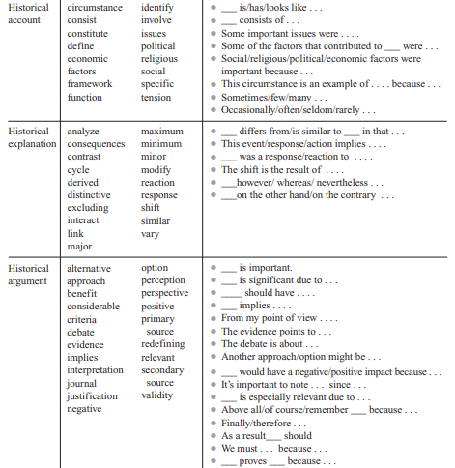
Guidance sheet: academic language
Academic language can be both general and content specific. That is, many academic words are used across all subject areas (such as interpret, conflict, analyse, whereas others pertain to specific topic areas (constitution, revolutionary, democratic).
Below is a list of academic language and sentence starters you should look to incorporate into your own write up:

Slide 26
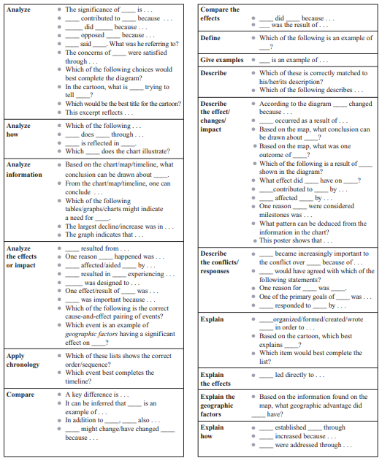
Guidance sheet: academic language

Slide 27
Guidance sheet: using quotations
In history, you will often find yourself working with the words and ideas of others. It is therefore very important to learn to paraphrase accurately and cite your sources according to a recognized manual of style.
Paraphrasing
Paraphrasing is the act of putting information from another source in your own words. This is more than simply changing a couple of words in a sentence. One easy and effective way to paraphrase is to read the passage you are referencing, close the book or put away the article, and try to summarize the ideas yourself.
Considering the following block quote by James Truslow Adams in his book The Epic of America (U.S.A. Taylor & Francis, 1935), p.415:
Unfortunately, today’s reality is not The American Dream. In reality, tens of millions in America cannot work hard and make their dreams come true simply because they cannot get a job. The healthcare and welfare systems are so unequal and warped that they only perpetuate the socio-economic inequalities. In truth, only few people realize The American Dream while the rest continue to struggle to avert poverty.
One way to paraphrase the above passage is:
One of the main factors preventing the American Dream becoming a reality for all is, according to Adams’, due to the social and economic inequalities faced in America today.
While the paraphrased passage does not use Adams’ exact words to express an opinion about the American Dream today, it still draws the ideas from his book, and makes it clear the point being put across is Adams’.

Slide 28
Guidance sheet: using quotations
Quoting
Sometimes the exact words of an author are so important you may want to quote them directly. There are four things to remember when you do this:
Always anchor your quote. The words of another author should not just float around in the middle of your paragraph, or be a sentence on their own, but must serve to support an argument you are making. You should therefore always make sure that you properly introduce your quote (who wrote it, for example?).
Quote sparingly. Ninety-nine percent of your paper should be in your own words. Quotes help your argument, but cannot substitute for your own original work.
Words that belong to someone else must be copied exactly and enclosed in quotation marks.
You must tell your reader where the information comes from. Always cite your source in brackets afterwards to show exactly where it came from (the book title, or website for example).
An example of how to follow these guidelines, using the same passage as before, would be:
Not all historians agree that the question of the reality of the American Dream today is a simple matter. As historian Adams argues, "tens of millions in America cannot work hard and make their dreams come true simply because they cannot get a job" (Adams, The Epic of America). Rather than think of the American Dream in clear cut terms, we should recognize the different factors affecting the reality of the American Dream, he suggests.
It is important to note that Adams’ words are quoted EXACTLY as they appear in his book, along with an immediate citation following in brackets to show where this passage has come from.

Slide 29
Task 15 - The write up!
Using the previous guidance sheets, and your plan, you are now ready to write up your final answer to the question:
How has the American Dream changed in the last century?
Please submit your assignment to Miss Best when completed; hbest@raynespark.merton.sch.uk

